Slide 1
Manipulator grabbing position detection with information fusion of color image and depth image using deep learning
Reviewed by Samah Ahmed, Md. Touhiduzzaman & Maher Al Islam
Jiang, D., Li, G., Sun, Y. et al. J Ambient Intell Human Comput 12, 10809–10822 (2021).
https://doi.org/10.1007/s12652-020-02843-w

Slide 2
Introduction
It is particularly important for the robot to achieve stable grasping in unstructured environment
Researchers have spent a lot of time to solve this problem
Artificial design features
Complete three-dimensional model of the object
Deep learning technology is used in computer vision
Detection, tracking, and intelligent recognition
It improves the accuracy and the processing speed
However, grasp unknown objects is challenging
Optimization of the deep learning framework for grasping multi-target objects
success rate of the model is enhanced (94.3%)
Notes:
1. artificial design features were used to express the grabbing information in the image, or the complete three-dimensional model of the object were used to generate the grasping position
2. However, in practical application, these methods have some limitation.
3. Deep learning technology has been applied successfully in computer vision for different reasons such as detection, tracking, and recognitions. And deep learning models achieve more accurate and processing speed.
4. On the other hand, grasp unknown objects is challenging because of the different shape and the posture of objects. The paper provides an optimization of the deep learning framework for multi- modal fusion for multi-target object stoic grasping, and the success rate of the model is enhanced

Slide 3
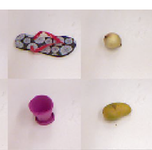
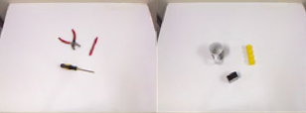
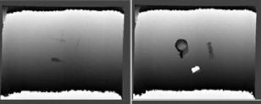
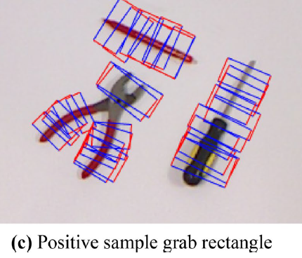
Dataset Preprocessing
They use multi-target data set that contains two types of images: single-object and multi-object
Each color image has its own corresponding depth map and grabbing rectangle annotation
Two dataset partition strategies are proposed:
Based on image
All images are randomly divided (ratio of 7:3)
To verify the detection process on grabbing frame when the objects have been seen in different angles
Based on object:
Training set is divided into different training sets
To ensure that the training set contains different classes of objects.
Notes:
In order to verify the success rate of multi-target capture detection model for new objects and the same object with different angles,

Slide 4
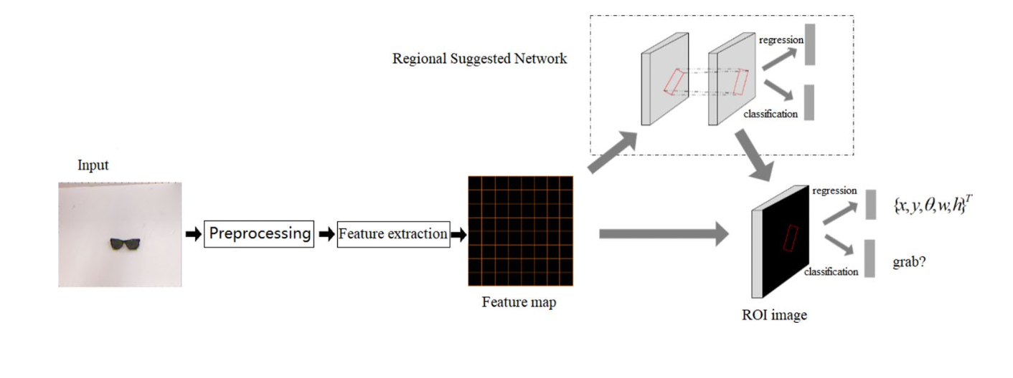
Detection Model
Convolution layer is used to extract the feature map from the input image
The feature map is used in regional suggested network to generate candidate boxes:
classify the target and background
make initial regression of grasping position
Two full connected classifiers are used to ensure the accuracy
In detection frame, there are two output:
•the score of grabbing(grabbing rectangular/non grabbing rectangular)
•coordinate of the suggested box
Notes:
Regression strategy of rotating rectangular box based on arbitrary angle is proposed.

Slide 5
Implementation
Four different input modes are used to train and test the model: color image, depth map, RGD, and depth fusion
The network has 14 convolution layers, 14 activation layers, and 4 pooling layers
convolution layers have:
Kernel_size=3, pad=1, stripe=1
Pooling layers have:
Kernel_size=2, pad=0, stripe=2

Slide 6
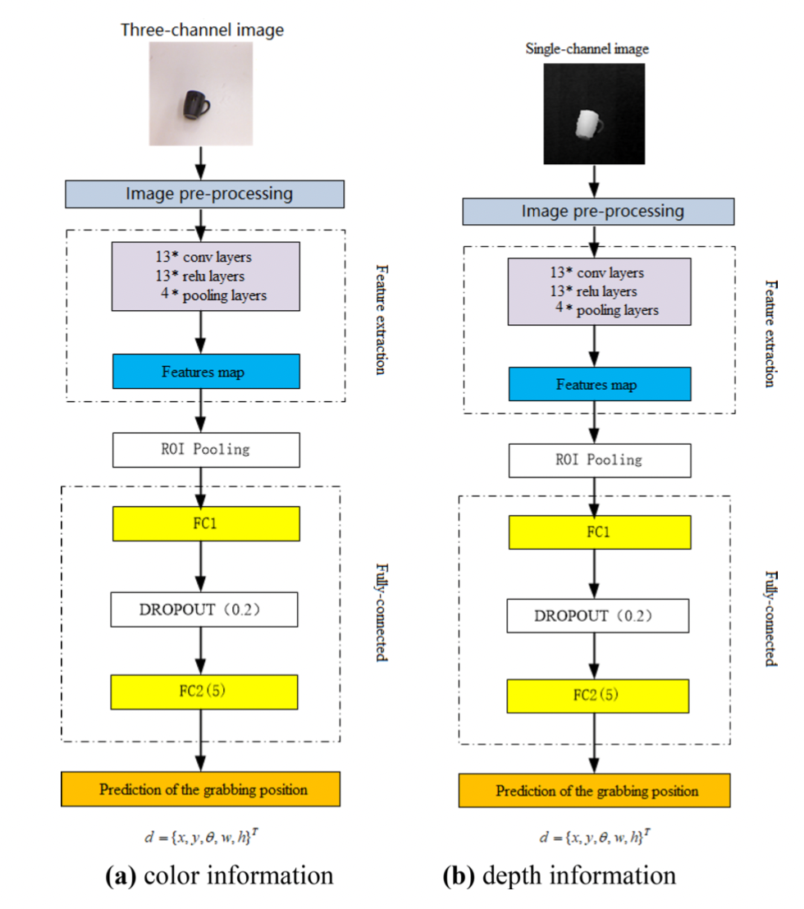
Detection Model

Slide 7
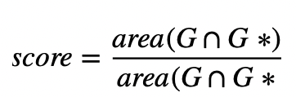
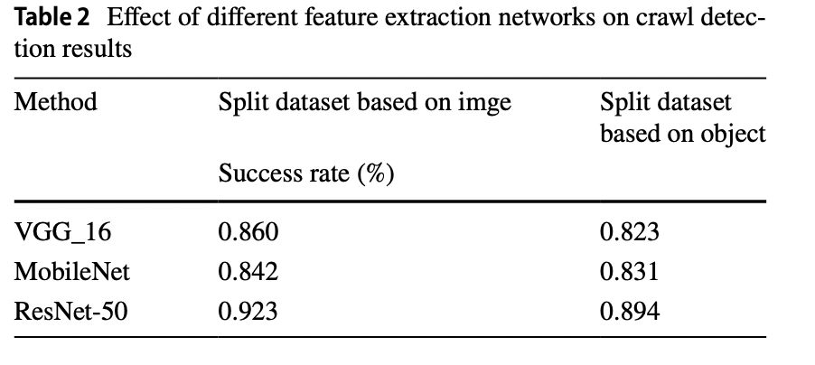
Analysis of experimental results
Two conditions have to satisfied to consider successful predicted grabbing rectangle:
The angle difference between the predicted grabbing frame g and the real label is less than 300
The score value is less than 0.25, where
Classic networks such as ResNet-50, MobileNet and VGG_16 were used to test the effect of different feature extraction networks
Notes:
the predicted grabbing rectangle is G and the real label rectangle is G*
From the experilmental results, we can see that resnet-50 has a better detec- tion effect for the grab model, and its success rate on image wise and object wise is the highest.

Slide 8
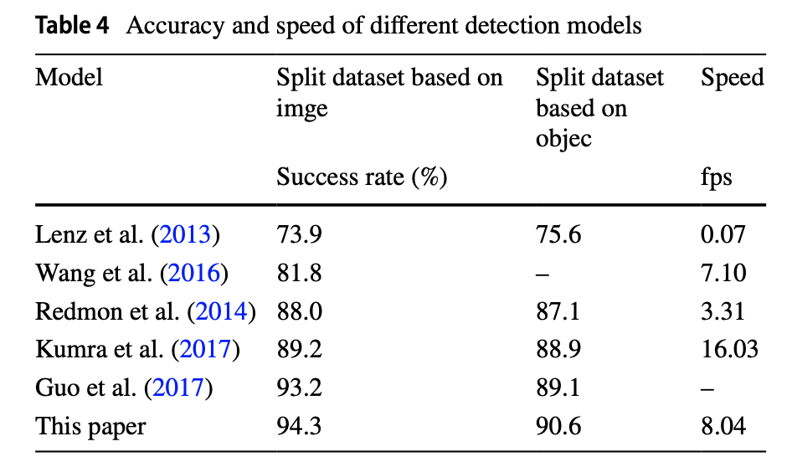
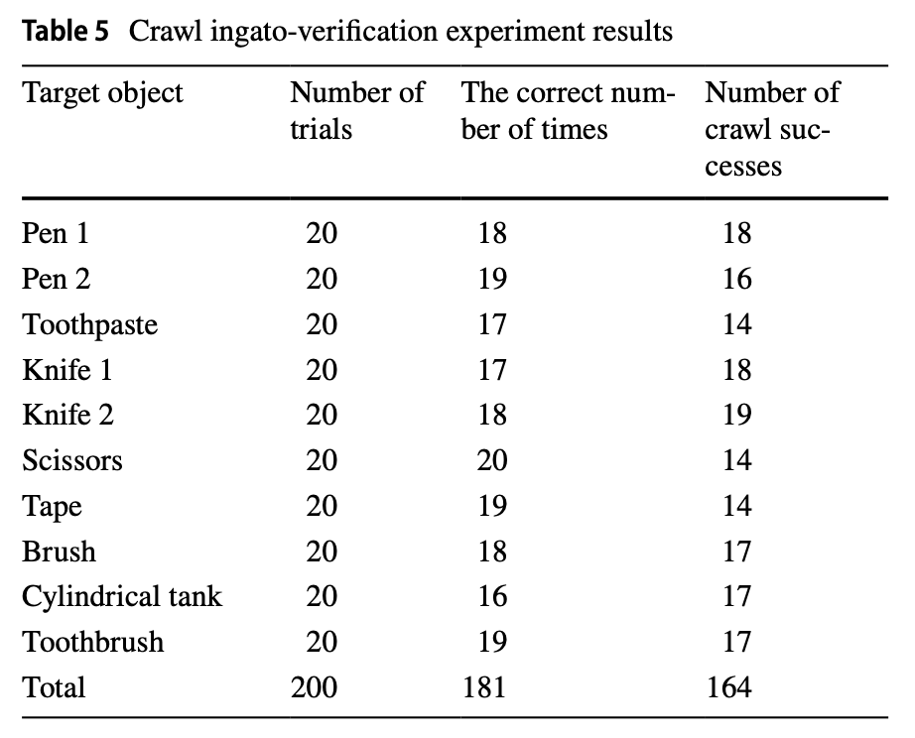
Analysis of experimental results
This paper: 94.3% vs 90.6%
181/200 correct predictions
164/200 crawl successes

Slide 9
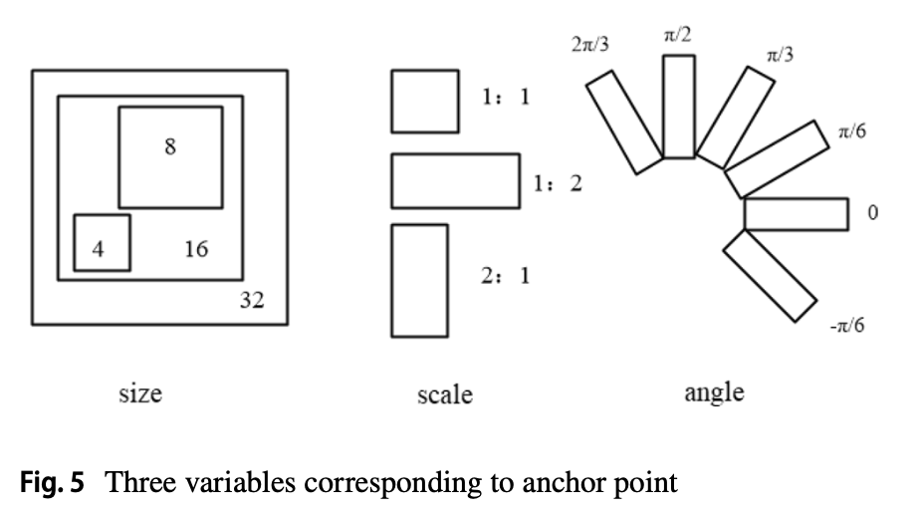
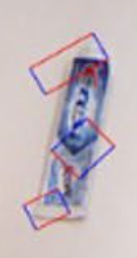
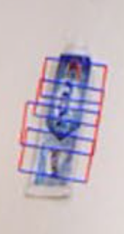
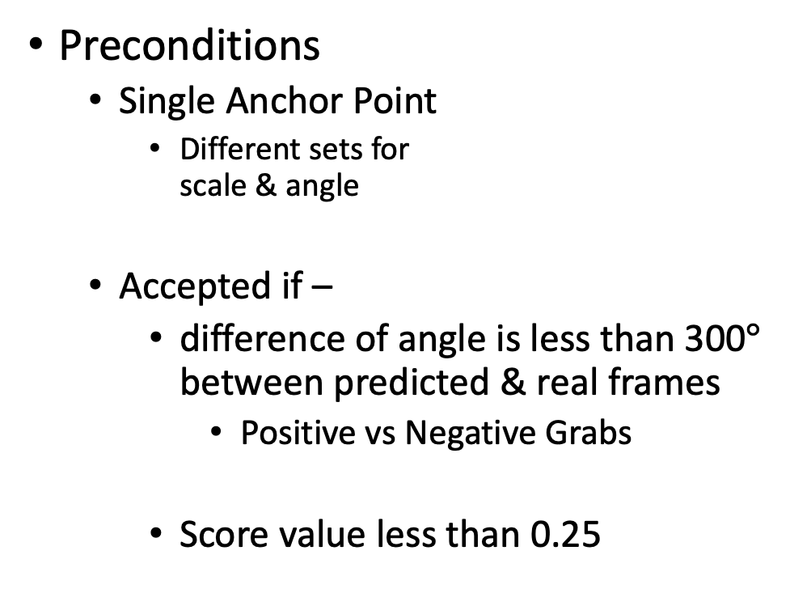
Critique
Preconditions
Single Anchor Point
Different sets for scale & angle
Accepted if –
difference of angle is less than 300$°$ between predicted & real frames
Positive vs Negative Grabs
Score value less than 0.25
Negative Grab
Positive Grab
Notes:
2 aspects to criticize the paper
Preconditions & Dataset
Anchor point – for different anchor points, we may have different scales & angles & thereby the model may fail to predict the grabbing region of the new image.
300 degree – so big that the negative grabbing samples may actually be considered as positive grabbing samples
0.25 – a quarter of even the randomly generated rectangles. So, basically, max 25% accuracy is fed into the model only by their definition of a match, which sounds a lot for an assumption.

Slide 10
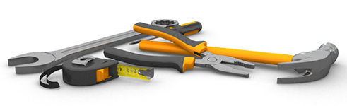

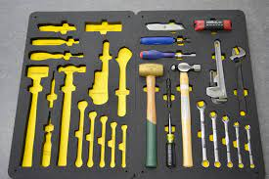
Critique
Dataset:
Lack of samples with -
Pile of objects
Colorful Background
Irregular Surroundings
Notes:
2nd point of view – more of the criticization of the selected dataset than the original approach
The selected dataset is from Chu et al., which is a publication from Cornell University in 2018.
This dataset lacks many practical scenarios to grab any object.
Pile of objects – the model may detect the whole pile as a single object & so may drive the robot to try a failed grab of the whole pile
Colorful Background – the model would fail to separate the object by their stated RGB approach, even the RG-D approach would fail in most of the cases
Irregular –the empty slots may be detected as objects leading failed attempts to grad those

Slide 11
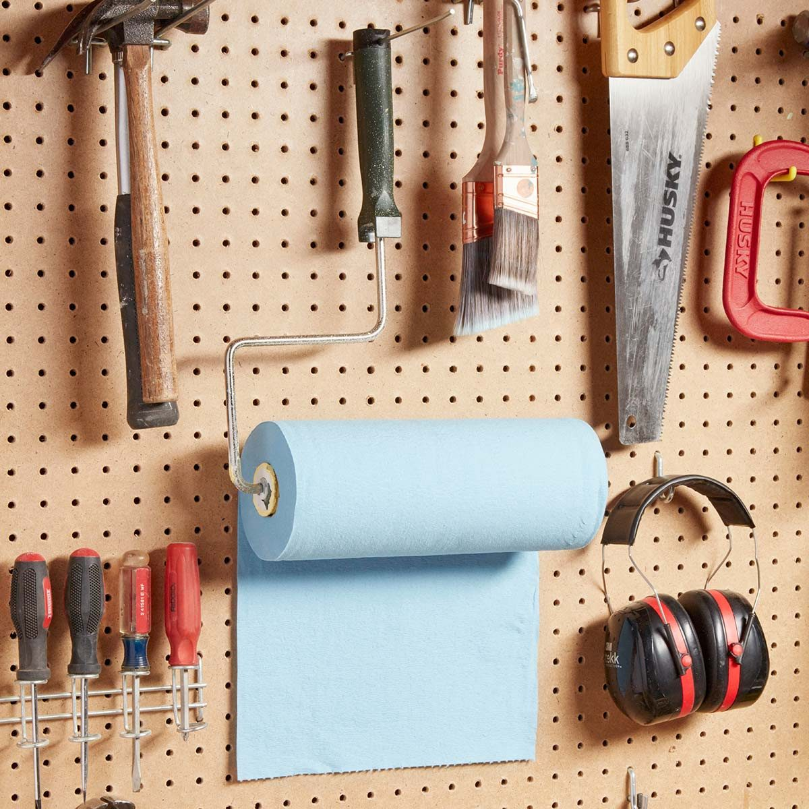
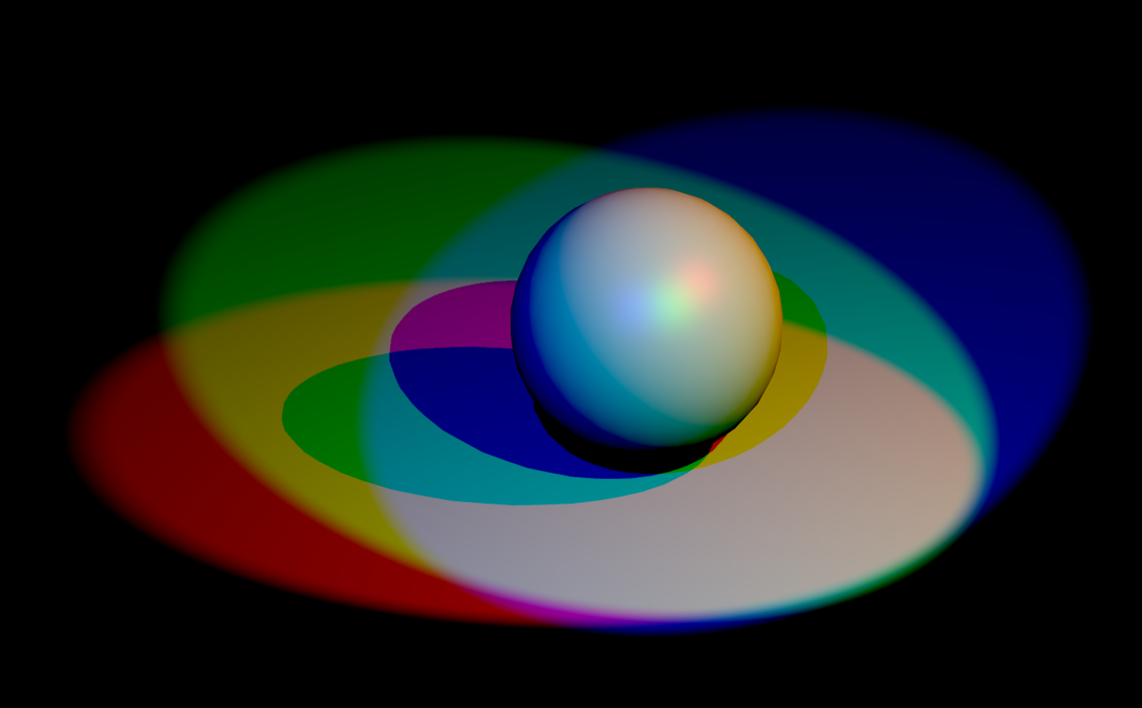
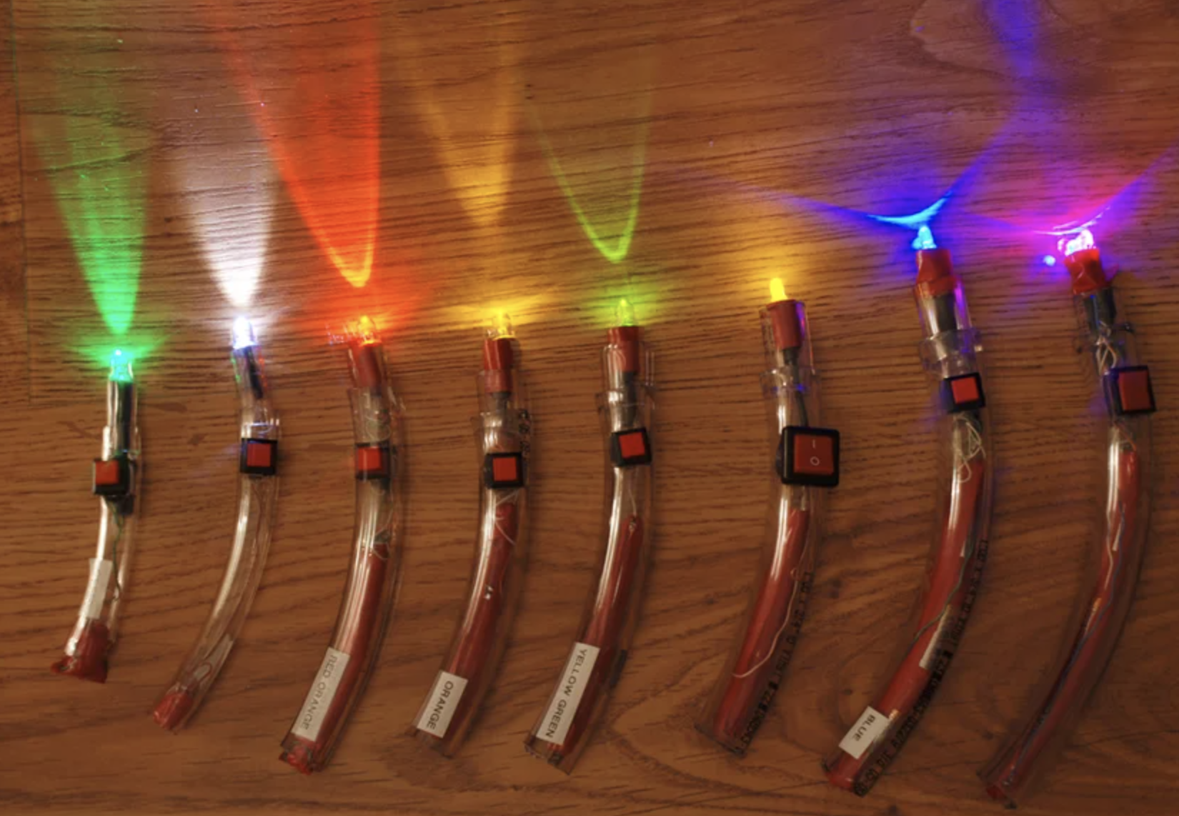
Critique
Dataset:
Lack of samples with -
Side View of the Objects
Shadows around Objects
Light Source from Different Angles
Colorful Light
Light Emitting Objects
Notes:
Only top-view is considered, no Side view is analyzed
Though, according to our understanding, it may lead to almost the same results, but the shadows may vary
Failed attempts to grab the shadows
Angle of Light - various shadows & various options to grab: for example, cup with a handle
Colorful Light – may hide necessary details for their RGB analysis
Light Emitting Objects – will make failed attempt to grab the lights
So, yes, there are a lot of practical scenarios to be considered in this topic, which are skipped in this paper.

Slide 12

Questions?

